Slide 1
C# .Net
Object Oriented Programming Language

Slide 2

Languages
You can write .NET apps in C#, F#, or Visual Basic.
C# is a simple, modern, object-oriented, and type-safe programming language.
F# is a cross-platform, open-source, functional programming language for .NET. It also includes object-oriented and imperative programming.
Visual Basic is an approachable language with a simple syntax for building type-safe, object-oriented apps.

Slide 3
What is .NET Framework?
.NET, .NET Framework, and .NET Core
There are various implementations of .NET. Each implementation allows .NET code to execute in different places—Linux, macOS, Windows, iOS, Android, and many more.
.NET Framework is the original implementation of .NET. It supports running websites, services, desktop apps, and more on Windows.
.NET Core is a cross-platform implementation for running websites, services, and console apps on Windows, Linux, and macOS. .NET Core is open source on GitHub.

Slide 4
Architecture of .NET Framework
The two major components of .NET Framework are the Common Language Runtime and the .NET Framework Class Library.
The Common Language me (RuntiCLR) is the execution engine that handles running applications. It provides services like thread management, garbage collection, type-safety, exception handling, and more.
The Class Library provides a set of APIs and types for common functionality. It provides types for strings, dates, numbers, etc. The Class Library includes APIs for reading and writing files, connecting to databases, drawing, and more.

Slide 5
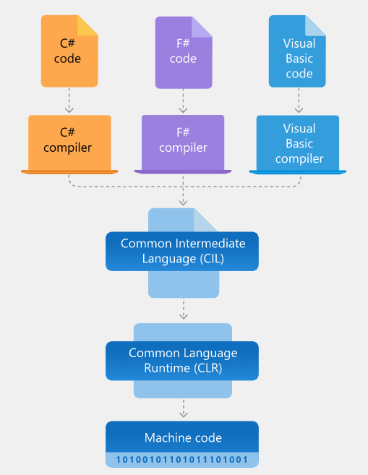
Architecture of .NET Framework

Slide 6
What is CLS and CTS ?
CTS and CLS are parts of .NET CLR and are responsible for type safety within the code. Both allow cross-language communication and type safety. In this article, I would like to expose the relationship between these two.

Slide 7
CLS - (Common Language Specification)
CLS stands for Common Language Specification and it is a subset of CTS. It defines a set of rules and restrictions that every language must follow which runs under the .NET framework. The languages which follow these set of rules are said to be CLS Compliant. In simple words, CLS enables cross-language integration or Interoperability.
For Example
if we talk about C# and VB.NET then, in C# every statement must have to end with a semicolon. it is also called a statement Terminator, but in VB.NET each statement should not end with a semicolon(;).

Slide 8
CTS - (Common Type System)
Common Type System (CTS) describes the datatypes that can be used by managed code. CTS defines how these types are declared, used and managed in the runtime. It facilitates cross-language integration, type safety, and high-performance code execution. The rules defined in CTS can be used to define your own classes and values.
OR we can also understand like,
CTS deals with the data type. So here we have several languages and each and every language has its own data type and one language data type cannot be understandable by other languages but .NET Framework language can understand all the data types.

Slide 9
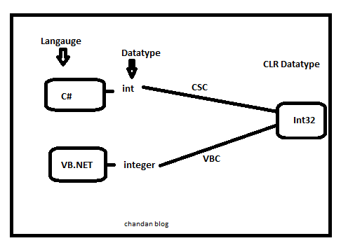
C# has an int data type and VB.NET has Integer data type. Hence a variable declared as an int in C# and Integer in VB.NET, finally after compilation, uses the same structure Int32 from CTS.

Slide 10
BCL Basic Class Library
FCL - Framework Class Library
The Base Class Library (BCL) is literally that, the base. It contains basic, fundamental types like System.String and System.DateTime.
The Framework Class Library (FCL) is the wider library that contains the totality: ASP.NET, WinForms, the XML stack, ADO.NET and more.

Slide 11
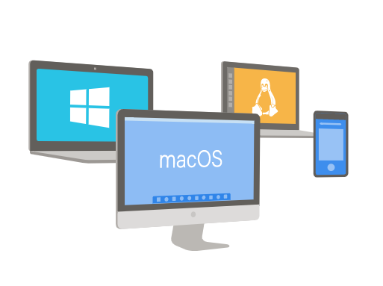
Cross Platform
Whether you're working in C#, F#, or Visual Basic, your code will run natively on any compatible OS. Different .NET implementations handle the heavy lifting for you:
.NET Core is a cross-platform .NET implementation for websites, servers, and console apps on Windows, Linux, and macOS.
.NET Framework supports websites, services, desktop apps, and more on Windows.
Xamarin/Mono is a .NET implementation for running apps on all the major mobile operating systems.

Slide 12

Libraries
To extend functionality, Microsoft and others maintain a healthy package ecosystem built on .NET Standard.
NuGet is a package manager built specifically for .NET that contains over 90,000 packages.

Slide 13
Metadata,Manifest,Assembly
Metadata is machine-readable information about a resource, or “data about data.” Such information might include details on content, format, size, or other characteristics of a data source. In .NET, metadata includes type definitions, version information, external assembly references, and other standardized information.
Manifest is nothing but a simple text file used to store metadata information of different .NET assemblies. Manifest file can be saved as a stand alone file of type PE. It can also be stored as an exe or as a dll file containing intermediate language code.
Assembly is the smallest unit of deployment of a .net application. It can be a dll or an exe.
A .NET program consists of one or more assemblies.

Slide 14
Introduction to C#
C# is a strongly typed object-oriented programming language. C# is open source, simple, modern, flexible, and versatile. In this article, let’s learn what C# is, what C# can do, and how C# is different than C++ and other programming languages.
A programming language on computer science is a language that is used to write software programs.
C# is a programming language developed and launched by Microsoft in 2001. C# is a simple, modern, and object-oriented language that provides modern day developers flexibility and features to build software that will not only work today but will be applicable for years in the future.

Slide 15
C# is modern and easy
C# is a simple, modern, and an object-oriented programming language. The purpose of C# was to develop a programming language that is not only easy to learn but also supports modern day functionality for all kind of software development.

Slide 16
C# is fast and open source
C# is open source under the .NET Foundation, which is governed and run independently of Microsoft. C# language specifications, compilers, and related tools are open source projects on Github. While C# language feature design is lead by Microsoft, the open source community is very active in the language development and improvements.
C# is fast compare to several other high-level programming languages. C# 8 has many performance improvements.

Slide 17
C# is cross platform
C# is cross platform programming language. You can build .NET applications that can be deployed on Windows, Linux, and Mac platforms. C# apps can also be deployed in cloud and containers.

Slide 18
Elvin Camalzade

